Slide 1
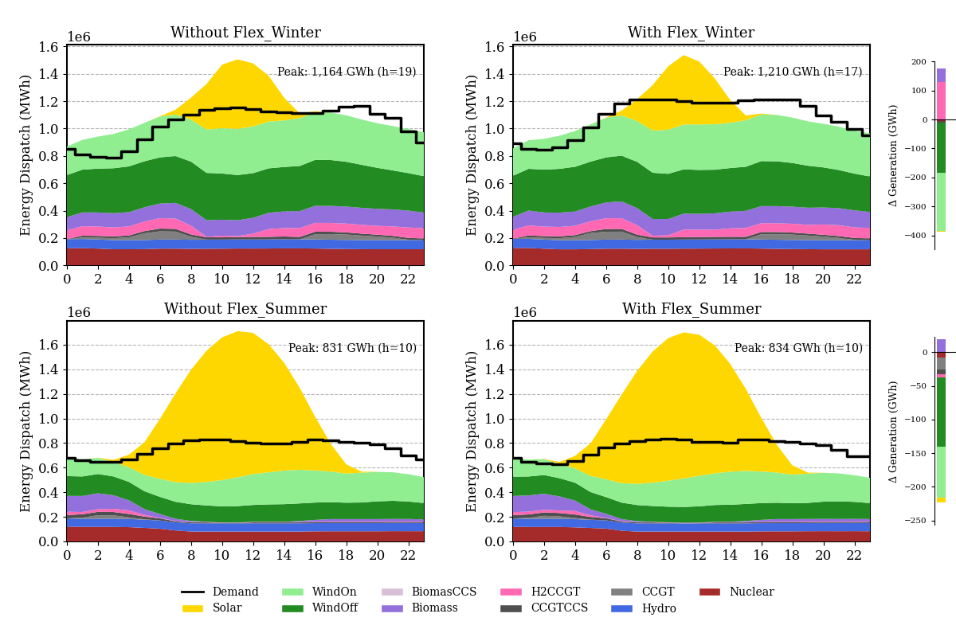

a
b
c
High wind at early morning
High solar at noon

